Slide 1

Enabling Continuous Integration with Azure Pipelines
Eng Teong Cheah
Microsoft MVP for Developer Technologies

Slide 2
What is Continuous Integration?

Slide 3
Continuous Integration (CI)
CI is the process of automating the build and testing of code every time a team member commits changes to version control.
CI encourages developers to share their code and unit tests by merging their changes into a shared version control repository after every small task completion.
Committing code triggers an automated build system to grab the least code from the shared repository and to build, test, and validate the full master branch(aka trunk and main).

Slide 4
Benefits of Continuous Integration
Manual tests are only a snapshot
Increase your code coverage
Deploy your code to production
Build stuff now
Build stuff faster
Never ship broken code
Decrease code review time
Build repeatable processes

Slide 5
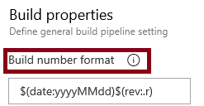
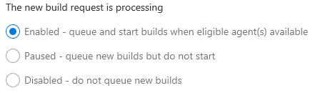
Build Number Formatting and Build Status
Build number formatting
- Build status (enabled, paused, disabled)

Slide 6
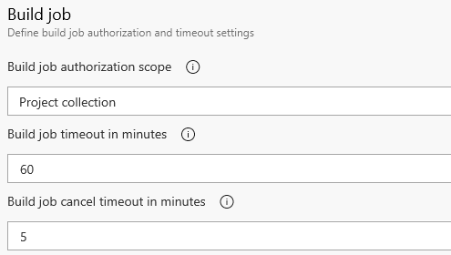

Authorization and Timeouts, and Badges
Authorization and Timeouts (scope, job timeout, cancel job timeout)
- Build status (enabled, paused, disabled)

Slide 7
Demo

Slide 8
Resources
docs.microcsoft.com

